Slide 1
e-Procurement Ontology
Publications Office – Unit C2
5th Working Group Meeting: 2018-03-28

Slide 2
Glossary feedback (Working Group)
Conceptual Data Model (Maria Font)
Preparation of the PoC (Enric Staromiejski)
Questions

Slide 3
1. Glossary feedback
No issues or feedback received about the Glossary
Are there any improvement points for the Glossary?
Are there any missing concepts and definitions?

Slide 4
Glossary feedback (Working Group)
Conceptual Data Model (Maria Font)
Preparation of the PoC (Enric Staromiejski)
Questions

Slide 5
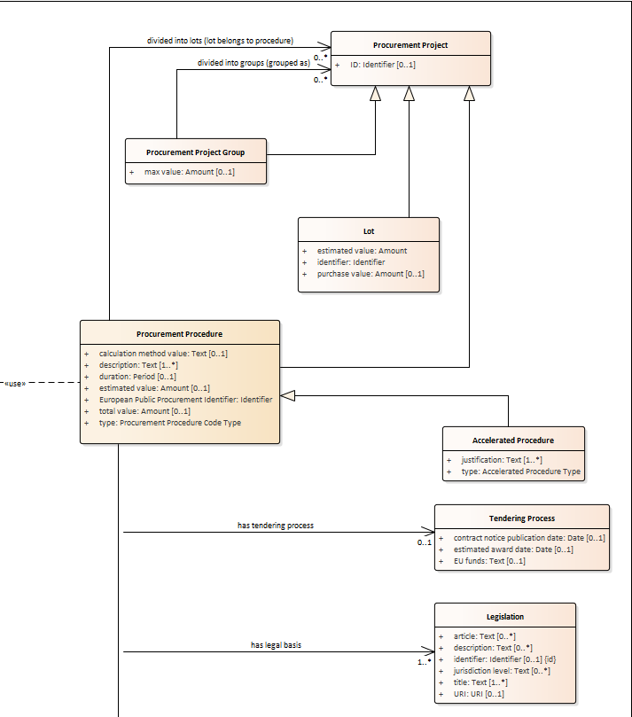
2. Conceptual Data Model
Objectives for the WG members:
Review completeness
Review coherence
Issue considerations on desing aspects
→ Proposal: regular meetings with subgroup of technical experts
https://github.com/eProcurement-everis/ePO/wiki/Conceptual-Model#classes

Slide 6
Glossary feedback (Working Group)
Conceptual Data Model (Maria Font)
Preparation of the PoC (Enric Staromiejski)
Questions

Slide 7
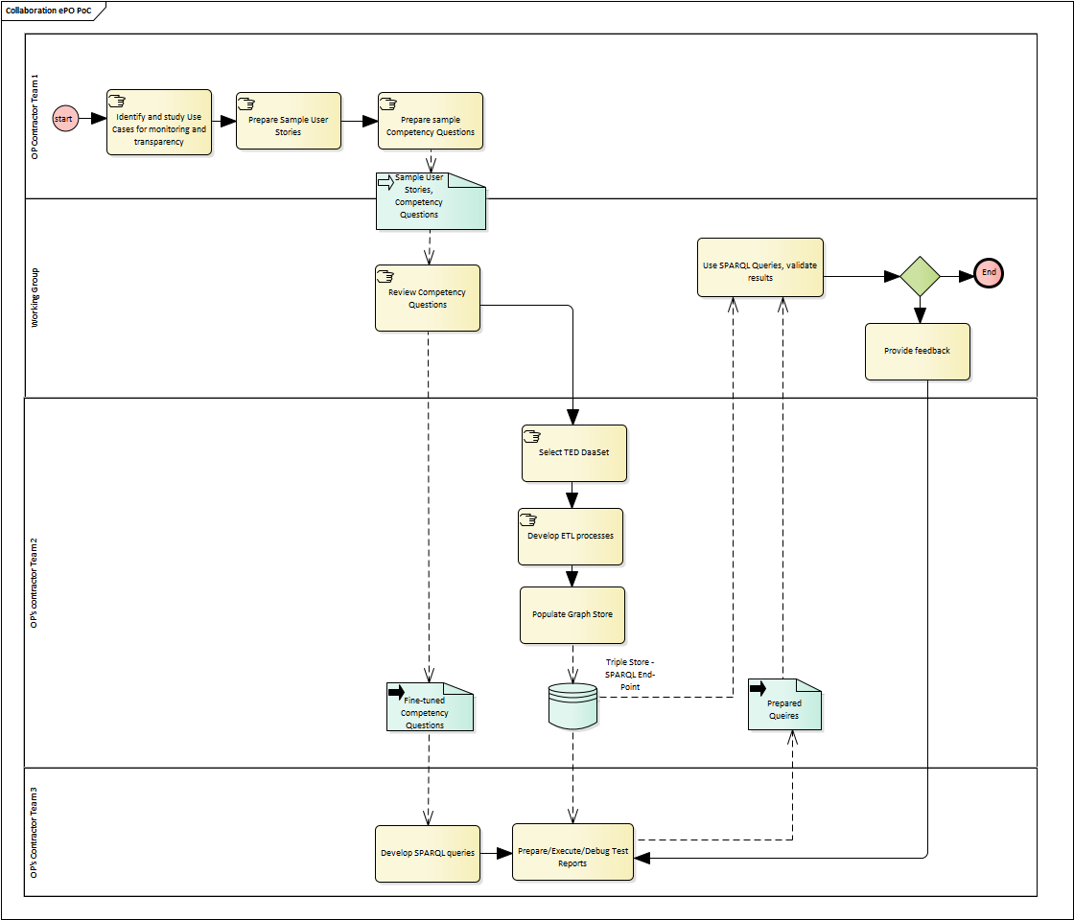
3. Preparation of the PoC
PoC Workflow
https://github.com/eProcurement-everis/eProcurement-everis.github.io/blob/master/images/ePO_PoC.png

Slide 8
3. Preparation of the PoC
CQ Methodology
1
Use Cases
User Stories
Competency Questions
Use case 1. Data journalism
Use case 4. Analyzing eProcurement procedures
e.g., as a journalist I want to know the contract value for tram maintenance at country level by selecting awards that refer to some CPV codes in order to compare it with other countries.
e.g., for a given CPV, the number of contracts awarded for that CPV and the total value amount awarded.
2
3
https://github.com/eProcurement-everis/ePO/blob/master/02_IR_DED/WayforwardCompetencyQuestions.pdf
https://github.com/eProcurement-everis/ePO/wiki/Competency-Questions

Slide 9
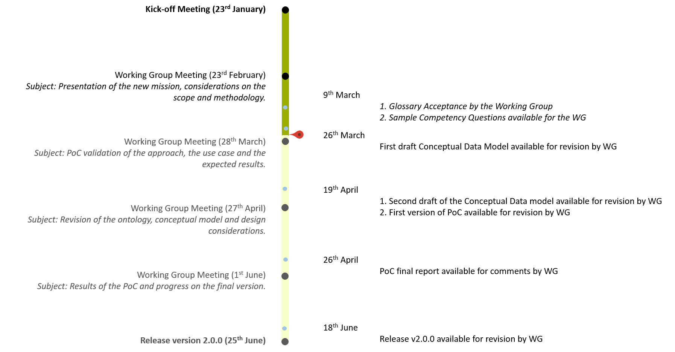
3. Preparation of the PoC
PoC Deadline

Slide 10
Glossary feedback (Working Group)
Conceptual Data Model (Maria Font)
Preparation of the PoC (Enric Staromiejski)
Questions

